Slide 1

By: Team BEKO
Challenge: Improving IT service delivery to federal departments
February 4-7 2022

Slide 2
TEAM BEKO Members
Bochen Guo
Onyinye Chikezie
Ezekiel Ayeni
Kong-Fai Chow

Slide 3
Objective
We intend on showing how the relationship between each of these variables provide insight to conditions under which incidents take longer to restore
Is there a correlation between the number of times a ticket is reassigned and how long it takes to restore?
Is there a correlation between assigned groups and the length of time it takes to restpre service?
Are there particular organizations or services for which it takes longer on average to restore service?
Is there correlation between the number of tickets associated with a particular assigned group, organization or service and the time it takes to restore service?
Is there any difference in MTRS when event management tickets are included or excluded from the analysis?

Slide 4
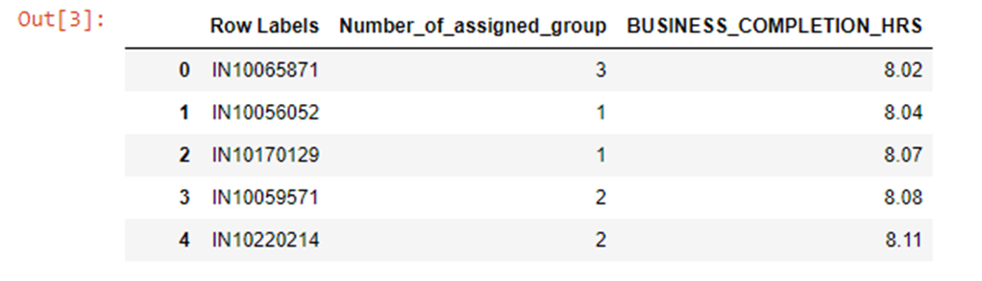
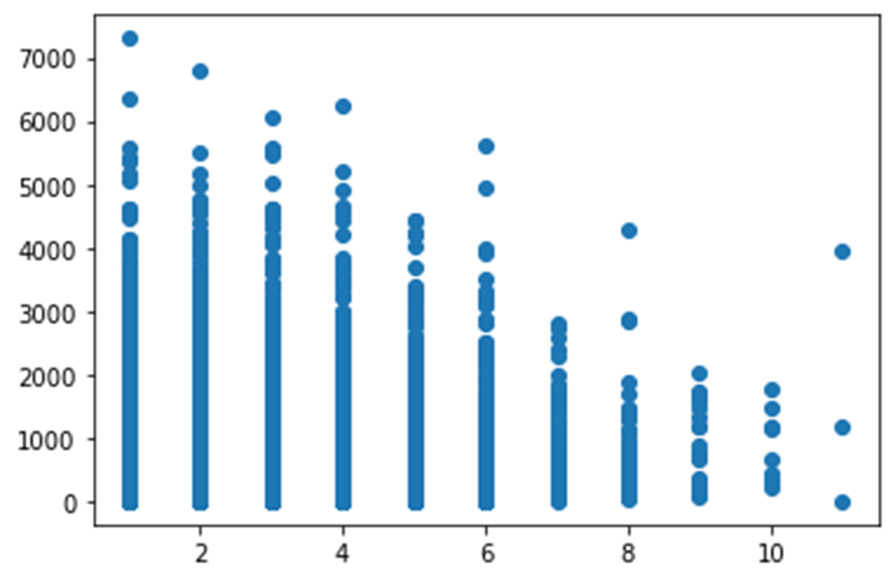
Correlation between the time a ticket is reassigned and number and the time it takes to restore?
Going by the service standards of SSC incident management these are the times appropriated for different incidents
- High Priority – 8 hours (24x7)
- Medium Priority – 2 business days (10 hr workdays, weekdays, no federal holidays)
- Low Priority – 6 business days

Slide 5
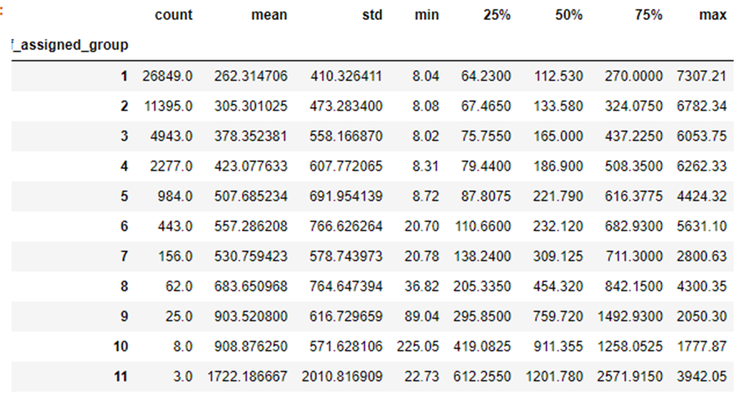
Number of times incidents were assigned to Groups

Slide 6
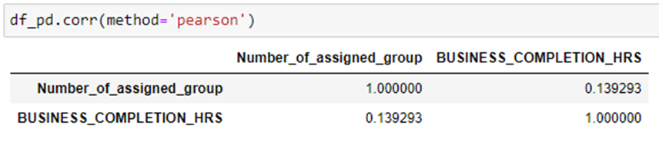

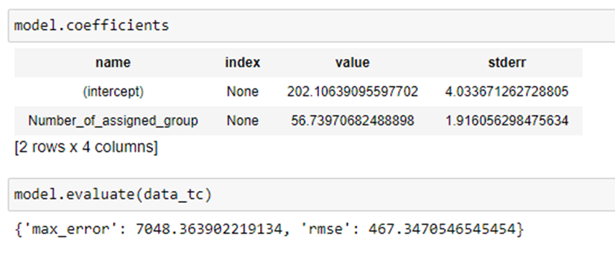
Hour = 202+57 *# of assigned group

Slide 7
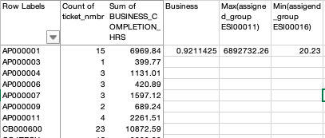
Correlation between the assigned groups and the length of time it takes to restore service?
KEY THINGS WE NOTE
Correlation value of 0.9211425(very high),
The greatest contributor - ESI00011 with 6892732 business hrs
The least contributor- ESI00016 with 20.3 business hrs
Average service restore time
- High Priority – 8 hours (24x7)
- Medium Priority – 2 business days (10 hr workdays, weekdays, no federal holidays)
- Low Priority – 6 business days

Slide 8
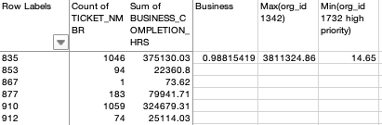
Correlation between organizations for which it takes longer on average to restore service?
KEY THINGS WE NOTE
Correlation value of 0.988154194(very high)
The org_id that takes the longest(longer than average) is 1342 with a time of 3811324.26
The org_id that takes the shortest(longer than average) is 1742 with a time of 14.65
Average service restore time
- High Priority – 8 hours (24x7)
- Medium Priority – 2 business days (10 hr workdays, weekdays, no federal holidays)
- Low Priority – 6 business days

Slide 9
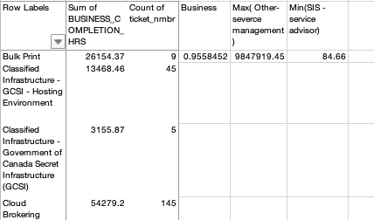
Correlation between services for which it takes longer on average to restore service?
KEY THINGS WE NOTE
Correlation value of 0.95584521(very high)
The service that take the longest(longer than average) was the Other-service management
The service that take the shortest(longer than average) was the SIS-service advisor
Average service restore time
- High Priority – 8 hours (24x7)
- Medium Priority – 2 business days (10 hr workdays, weekdays, no federal holidays)
- Low Priority – 6 business days

Slide 10
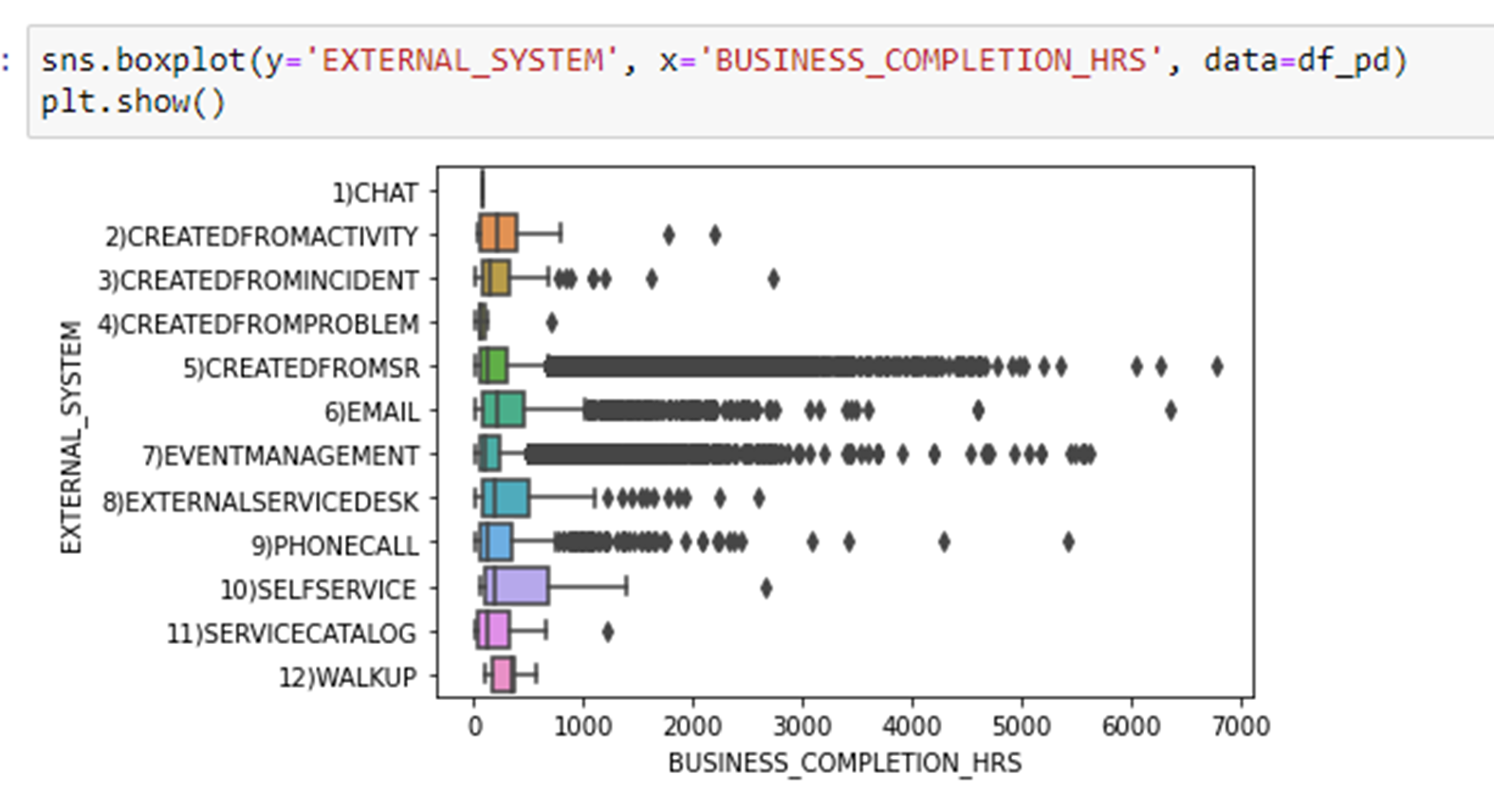
Is there any difference in MTRS when event management tickets are included or excluded from the analysis?

Slide 11
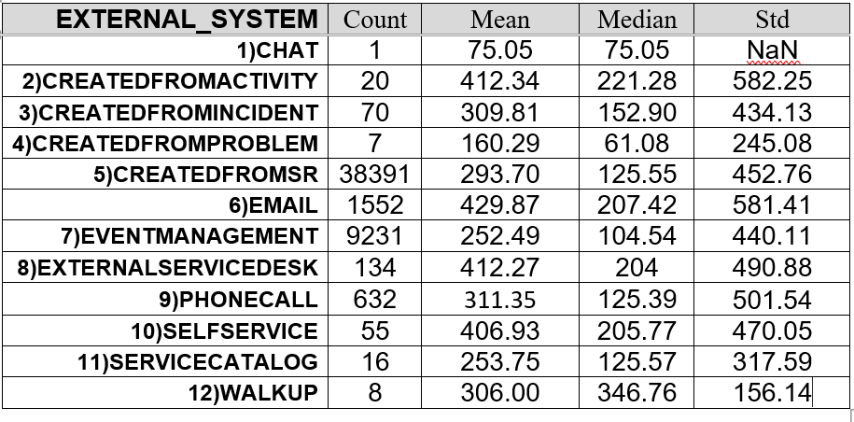
KEY THINGS WE NOTE
The greatest contributor - CREATEDFROMSR with a count of 38391
The least contributor- CHAT with a count of 1

Slide 12
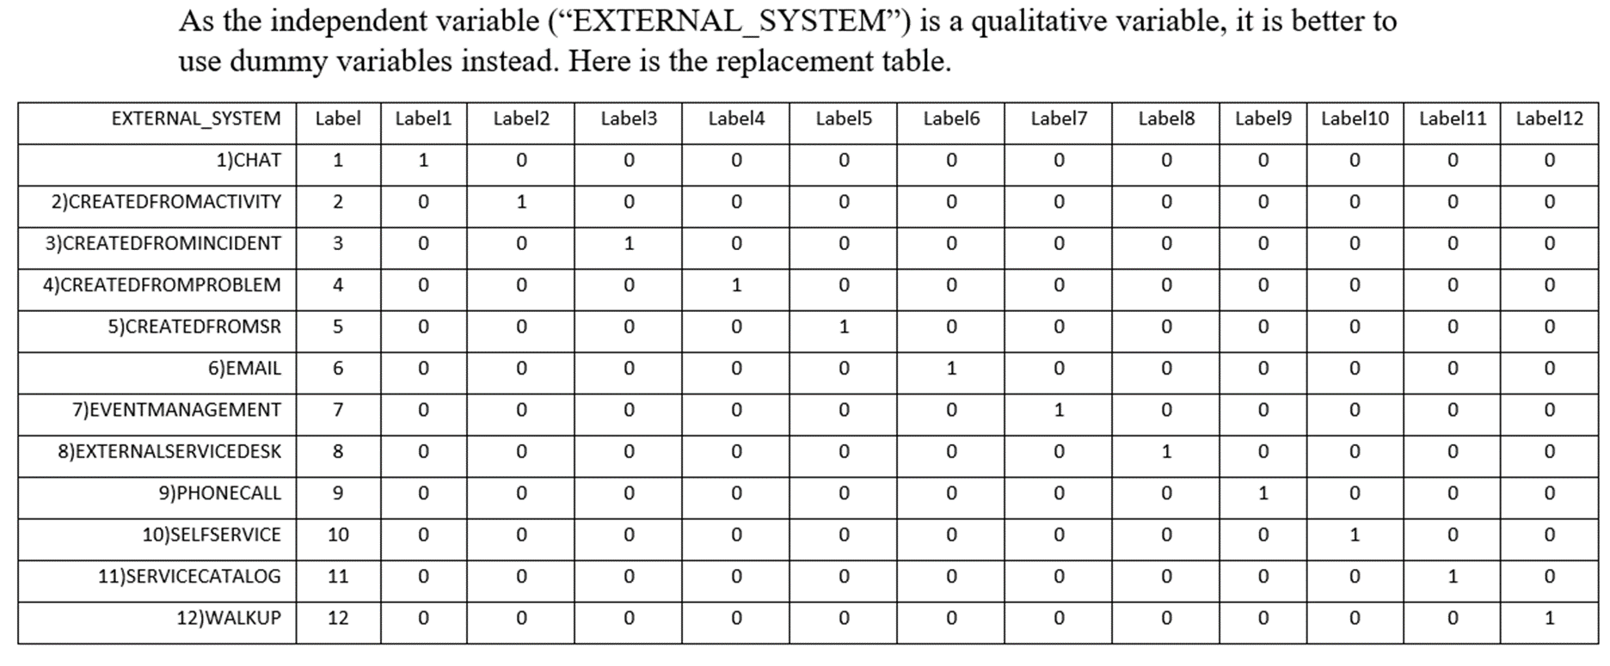

Slide 13
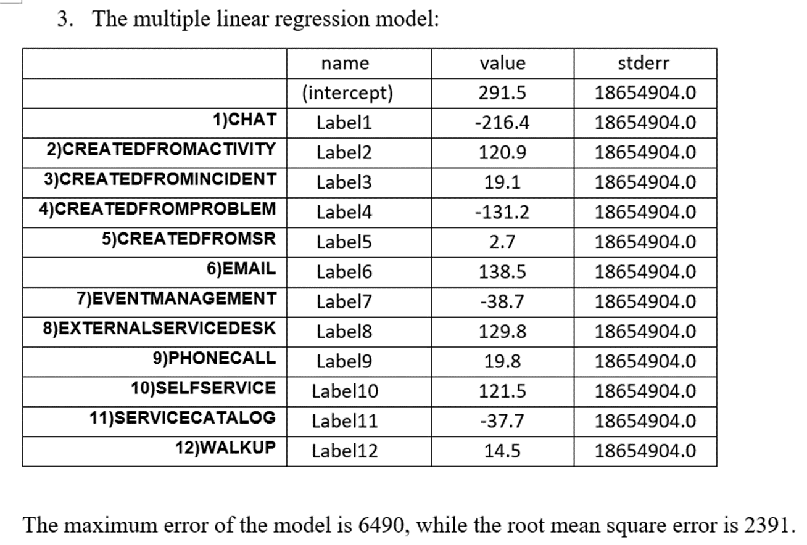
External System vs Business Completion time

